Slide 2
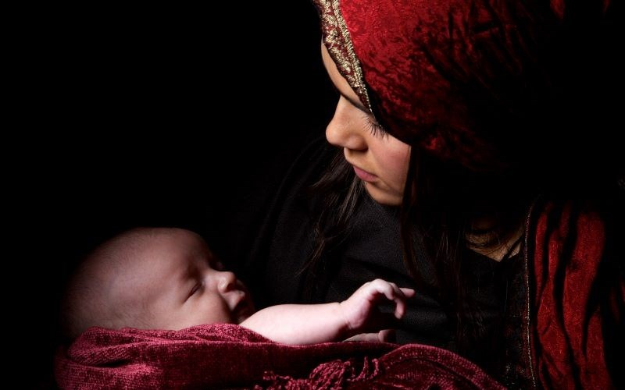
Mary Did You Know?
Luke 2:19
“Mary treasured all these things, pondering them in her heart.”

Slide 3
“But you, O Bethlehem Ephrathah, who are too little to be among the clans of Judah, from you shall come forth for me one who is to be ruler in Israel, whose coming forth is from of old, from ancient days.”
Micah 5:2

Slide 4
“ For to us a child is born, to us a son is given; and the government shall be upon his shoulder, and his name shall be called Wonderful Counselor, Mighty God, Everlasting Father, Prince of Peace.”
Isaiah 9:6

Slide 5
Malachi 4:5 - 6 "Behold, I will send you Elijah the prophet before the great and awesome day of the LORD comes. 6 And he will turn the hearts of fathers to their children and the hearts of children to their fathers, lest I come and strike the land with a decree of utter destruction."

Slide 7
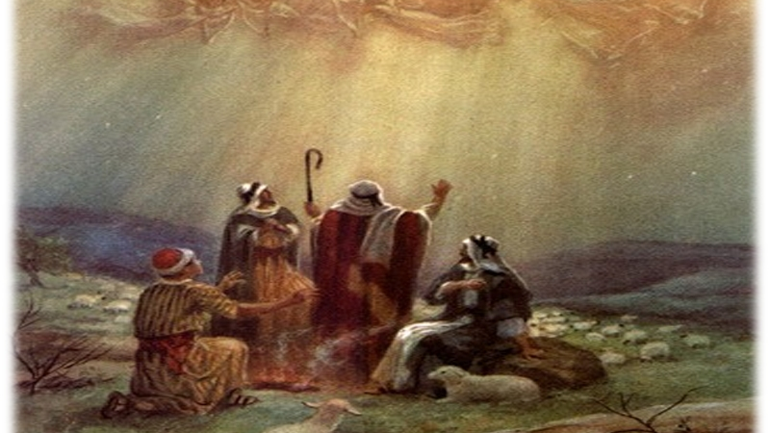

Slide 8
Mary Did You Know?

Slide 9
"Behold, this child is appointed for the fall and rising of many in Israel, and for a sign that is opposed 35 (and a sword will pierce through your own soul also), so that thoughts from many hearts may be revealed.“ Simeon Luke 2:34 - 35

Slide 10
“And when they had performed everything according to the Law of the Lord, they returned into Galilee, to their own town of Nazareth. 40 And the child grew and became strong, filled with wisdom. And the favor of God was upon him. Luke 2:39 - 40

Slide 12
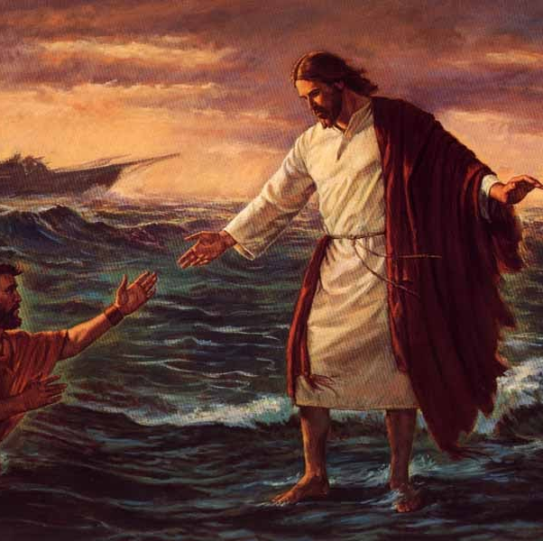
John 6:15 – 21
Mary did you know that your baby boy would one day walk on water?
This Photo by Unknown Author is licensed under CC BY-NC-ND

Slide 14
Your baby boy would save our sons and daughters.
“So his brothers said to him, "Leave here and go to Judea, that your disciples also may see the works you are doing.
John 7:4 For no one works in secret if he seeks to be known openly. If you do these things, show yourself to the world."
John 7:5 For not even his brothers believed in him.”

Slide 15
The Child that you Delivered will soon Deliver You.
John 1:29, 36 “The Lamb of God that takes away the sin of the world.”

Slide 16
Did you know that your baby boy would give sight to the blind?
“The eyes of the blind will be opened.”
Isa. 35:5

Slide 17
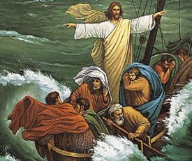
“And a great windstorm arose, and the waves were breaking into the boat, so that the boat was already filling. But he was in the stern, asleep on the cushion. And they woke him and said to him, "Teacher, do you not care that we are perishing?" And he awoke and rebuked the wind and said to the sea, "Peace! Be still!" And the wind ceased, and there was a great calm.” Mark 4:37 - 39

Slide 19
“When you kiss your little baby, You kiss the face of God.”
"Behold, the virgin shall conceive and bear a son, and they shall call his name Immanuel" (which means, God with us).” (Matthew 1:23)

Slide 20
Col. 1:15 – 17 “ He is the image of the invisible God, the firstborn of all creation. 16 For by him all things were created, in heaven and on earth, visible and invisible, whether thrones or dominions or rulers or authorities—all things were created through him and for him. 17 And he is before all things, and in him all things hold together.”
“Mary, did you know that your baby boy
Is Lord of all creation?

Slide 21
Psalm 2:8, 10 – 12 “ Ask of me, and I will make the nations your heritage, and the ends of the earth your possession… Now therefore, O kings, be wise; be warned, O rulers of the earth. Serve the LORD with fear, and rejoice with trembling. Give homage (Kiss) to the Son, lest he be angry, and you perish in the way, for his wrath is quickly kindled. Blessed are all who take refuge in him.”
“Mary, did you know that your baby boy
Would one day rule the nations?”

Slide 22
“Did you know that your baby boy Is heaven's perfect Lamb? That sleeping child you're holding is the great, I Am”
“The Lamb of God is the eternal – self existent great I AM (John 8:24, 28, 58) “Except you believe that I AM…”

Slide 23
Mary Did You Know?
Now we Know:
Who this virgin born, King of creation is.
The great I am who is the eternal self – existent One.
This king of creation is He king of my life?

